Slide 1

Migrating Data to an Autonomous Database Mv2ADB Demo
Eugene Simos Emea PreSales Team

Slide 2
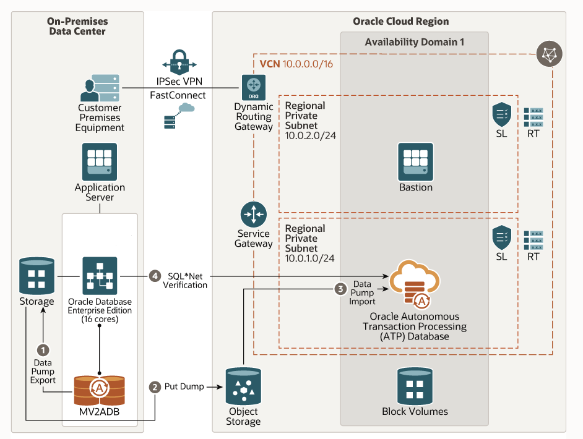
Reference Architecture

Slide 3
Steps to perform for the mv2adb tool
Download the Rpm file from Oracle Support
Install required libraires , oci client tool
Download and configure the Autonomous Wallet
Create sudo configuration to let non root users to use the tool (optional)
Create a bucket in Object Storage (optional)
Encrypt ALL passwords and the security OCI token
Create a configuration file for the mv2adb tool (database, object storage, autonomous db)
Check with the migrate advisor your database objects for errors
Migrate your data with the mv2adb ( with / without the configuration file)
Verify you data

Slide 4
Examples
sudo /opt/mv2adb/mv2adb.bin advisor -conf atp_mv2adb.config
sudo /opt/mv2adb/mv2adb.bin expdp -conf atp_mv2adb.config
sudo /opt/mv2adb/mv2adb.bin createbucket -conf atp_mv2adb.config (optional)
sudo /opt/mv2adb/mv2adb.bin putdump -conf atp_mv2adb.config
sudo /opt/mv2adb/mv2adb.bin impdp -conf atp_mv2adb.config
sudo /opt/mv2adb/mv2adb.bin report -conf atp_mv2adb.config

Slide 5
References
https://docs.oracle.com/en/solutions/migrate-to-autonomous-database-with-mv-to-adb/migrate-data1.html
https://www.oracle.com/database/technologies/instant-client/downloads.html
https://github.com/oracle/oci-cli
https://docs.oracle.com/pls/topic/lookup?ctx=en/solutions/migrate-to-autonomous-database-with-mv-to-adb&id=mos-mv2adb-pkg

